Slide 1
IBM University Engagement Project Submission
“Exploring the Power of Agentic AI with IBM Granite and IBM Bob”

Slide 2

Project Tile – [Interview Trainer Agent]
Domain of Project – [Education & Career Development]
Student Name | Recent Passport Photo | Email ID | Mobile number [WhatsApp]
Ayush Sharma |  | ayush.sh2177@gmail.com | 7206543544
Recommended font style and size: Font Style: Arial Font Size (Heading): 28
Font Size (Content): 20

Slide 3
Problem Statement -
Problem Statement: Interview Trainer Agent
The Challenge Preparing for job interviews is stressful and inconsistent — candidates often don't know what to expect for a specific role, experience level, or industry. Interview questions, behavioral scenarios, and HR expectations are scattered across job portals, professional networks, and company-specific interview experiences, making it hard to prepare in a structured way. Without personalized, role-specific guidance, many candidates walk into interviews underprepared, unsure of both the technical questions they'll face and how to present their soft skills convincingly.
The Objective Build an AI-powered Interview Trainer Agent that delivers personalized interview preparation for job seekers across experience levels and industries. The solution should:
Personalized Question Sets – Generate tailored interview questions based on profile name, experience level, and job role.
Interview Data RAG Retrieval – Fetch and summarize role-specific interview questions, industry expectations, behavioral scenarios, and HR guidelines from a structured knowledge base.
Resume-Based Preparation & Feedback – Allow users to input their resume or job title, and instantly receive targeted questions, model answers, and improvement tips.
Comprehensive Skill Assessment – Cover both technical and soft-skill/behavioral interview preparation for a well-rounded readiness experience.
Multi-Agent System –
Interview Knowledge Agent (retrieves role-specific questions, scenarios, and HR guidelines)
Question Recommendation Agent (builds personalized question sets and model answers)
Improvement Advisory Agent (delivers soft-skill and behavioral improvement tips)
Resume & Profile Analysis Agent (parses resume/job title to enrich personalization)
Visualization Dashboard – Show a readiness score, technical vs. behavioral category breakdown, and progress across practice sessions.

Slide 4
Proposed Solution -
Proposed Solution: AI-Powered Interview Trainer Agent
The proposed solution is a multi-agent AI-powered Interview Trainer Agent built using IBM Bob, IBM watsonx.ai, and Granite Models to provide personalized, role-specific interview preparation. The system addresses challenges in scattered interview information, inconsistent preparation strategies, and lack of personalized feedback through an intelligent, modular architecture.
At its core, the solution uses a Retrieval-Augmented Generation (RAG) pipeline to fetch accurate interview data from a structured knowledge base covering role-specific questions, industry expectations, behavioral scenarios, and HR guidelines. This data is embedded and stored in a vector database, enabling the system to retrieve and generate tailored questions, model answers, and improvement tips using Granite models.
The system consists of four key agents:
Interview Knowledge Agent retrieves and summarizes role-specific interview questions, industry expectations, and HR guidelines using RAG.
Question Recommendation Agent generates personalized question sets and model answers based on user inputs such as profile name, experience level, job role, and resume content.
Improvement Advisory Agent provides targeted feedback and improvement tips, covering both technical depth and behavioral/soft-skill communication.
Resume & Profile Analysis Agent allows users to input their resume or job title, parsing it to extract relevant skills and experience that enrich personalization.
The solution includes a user-friendly dashboard (built with React) that visualizes readiness scores, technical vs. behavioral category breakdowns, and progress across practice sessions.
IBM Bob is used to build and structure the agent's codebase, while watsonx.ai ensures model access, inference, and scalable deployment. Granite models power reasoning, question generation, and personalization, in line with the mandated use of IBM Cloud Lite services.
Overall, this solution delivers an end-to-end intelligent interview preparation assistant that builds candidate confidence, sharpens responses, and increases success rates in competitive hiring environments.

Slide 5
Technology Used
IBM Bob platform -For designing and orchestrating multi-agent workflows visually
IBM Grainte model - granite-4-h-small – For natural language understanding, reasoning, and personalization
IBM Cloud – It provides the infrastructure to build, deploy, and scale the Interview Trainer Agent efficiently. IBM Cloud enables a reliable, secure, and scalable environment for deploying the Interview Trainer Agent.
RAG – RAG to fetch real interview and role-specific data first, then generate intelligent, tailored responses, making the Interview Trainer Agent more trustworthy and effective.
IBM Watsonx.ai - For model deployment, embeddings, and AI governance
Vector Database (Chroma) – For RAG-based interview question and scenario retrieval.

Slide 6
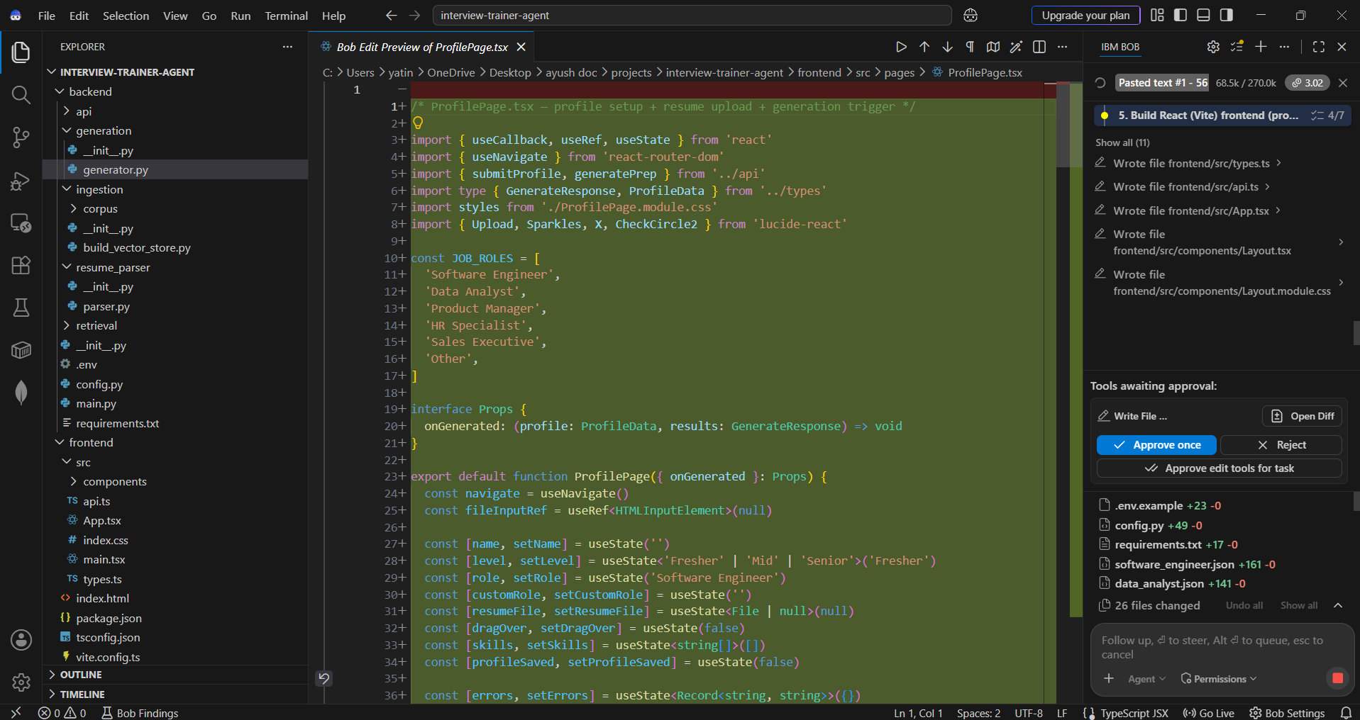
Required Files created using IBM bob -

Slide 7
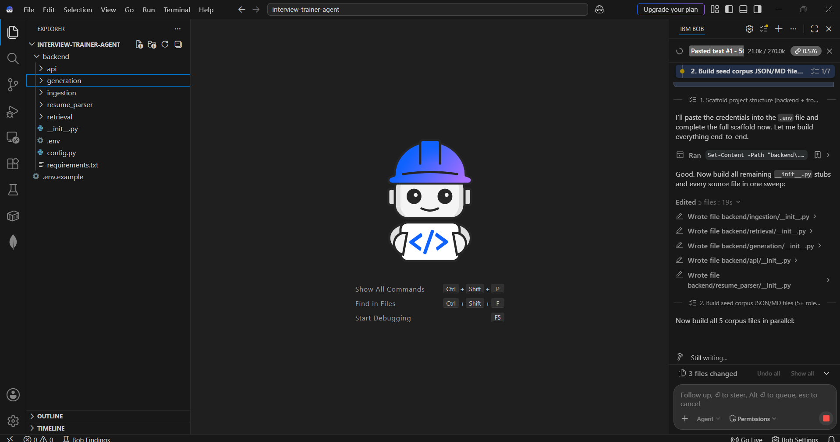
IBM Bob Screenshots:

Slide 8
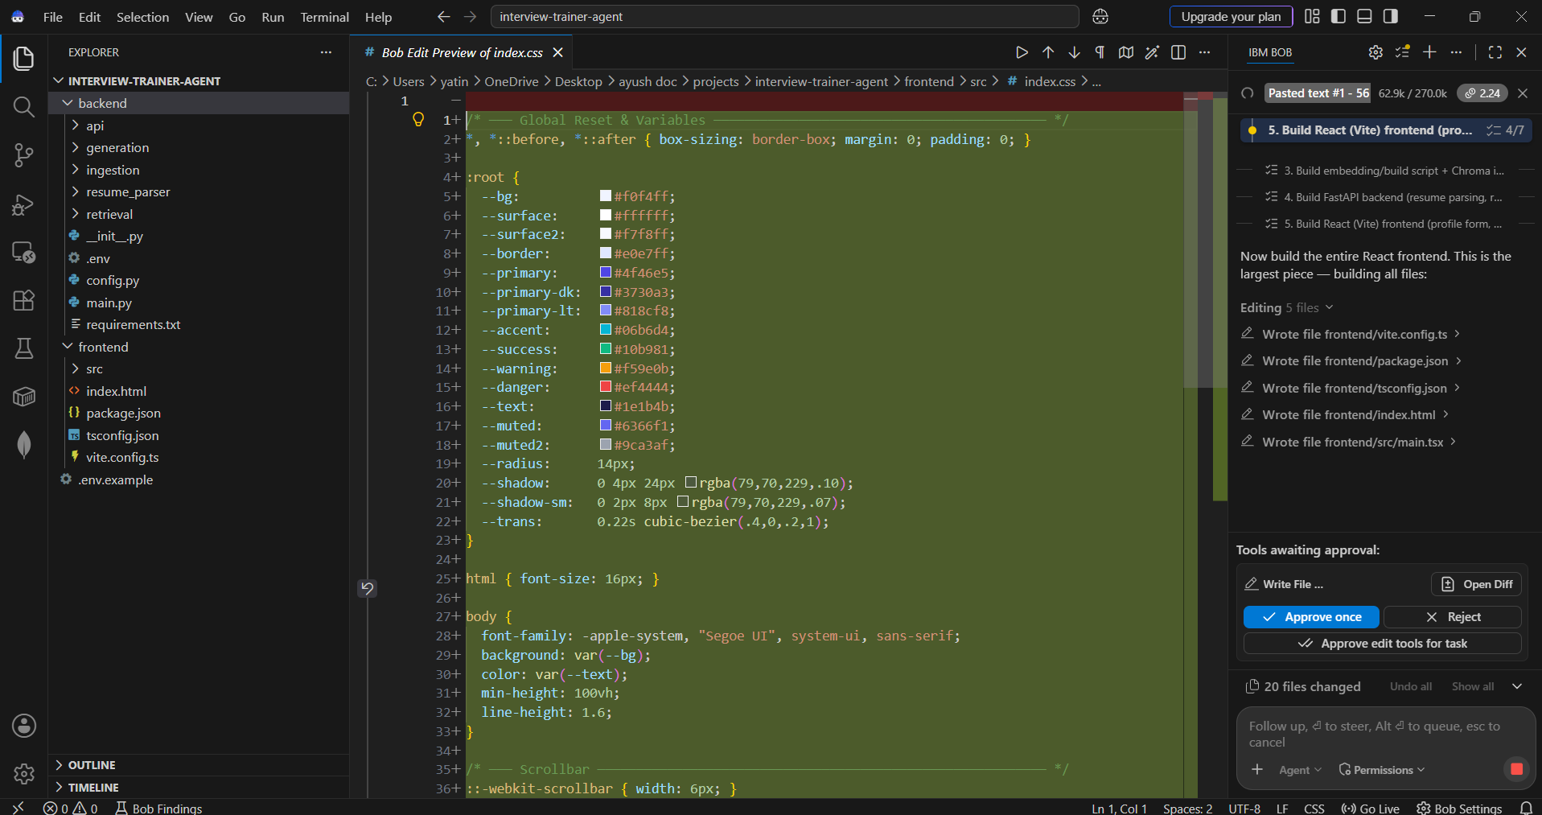

Slide 9
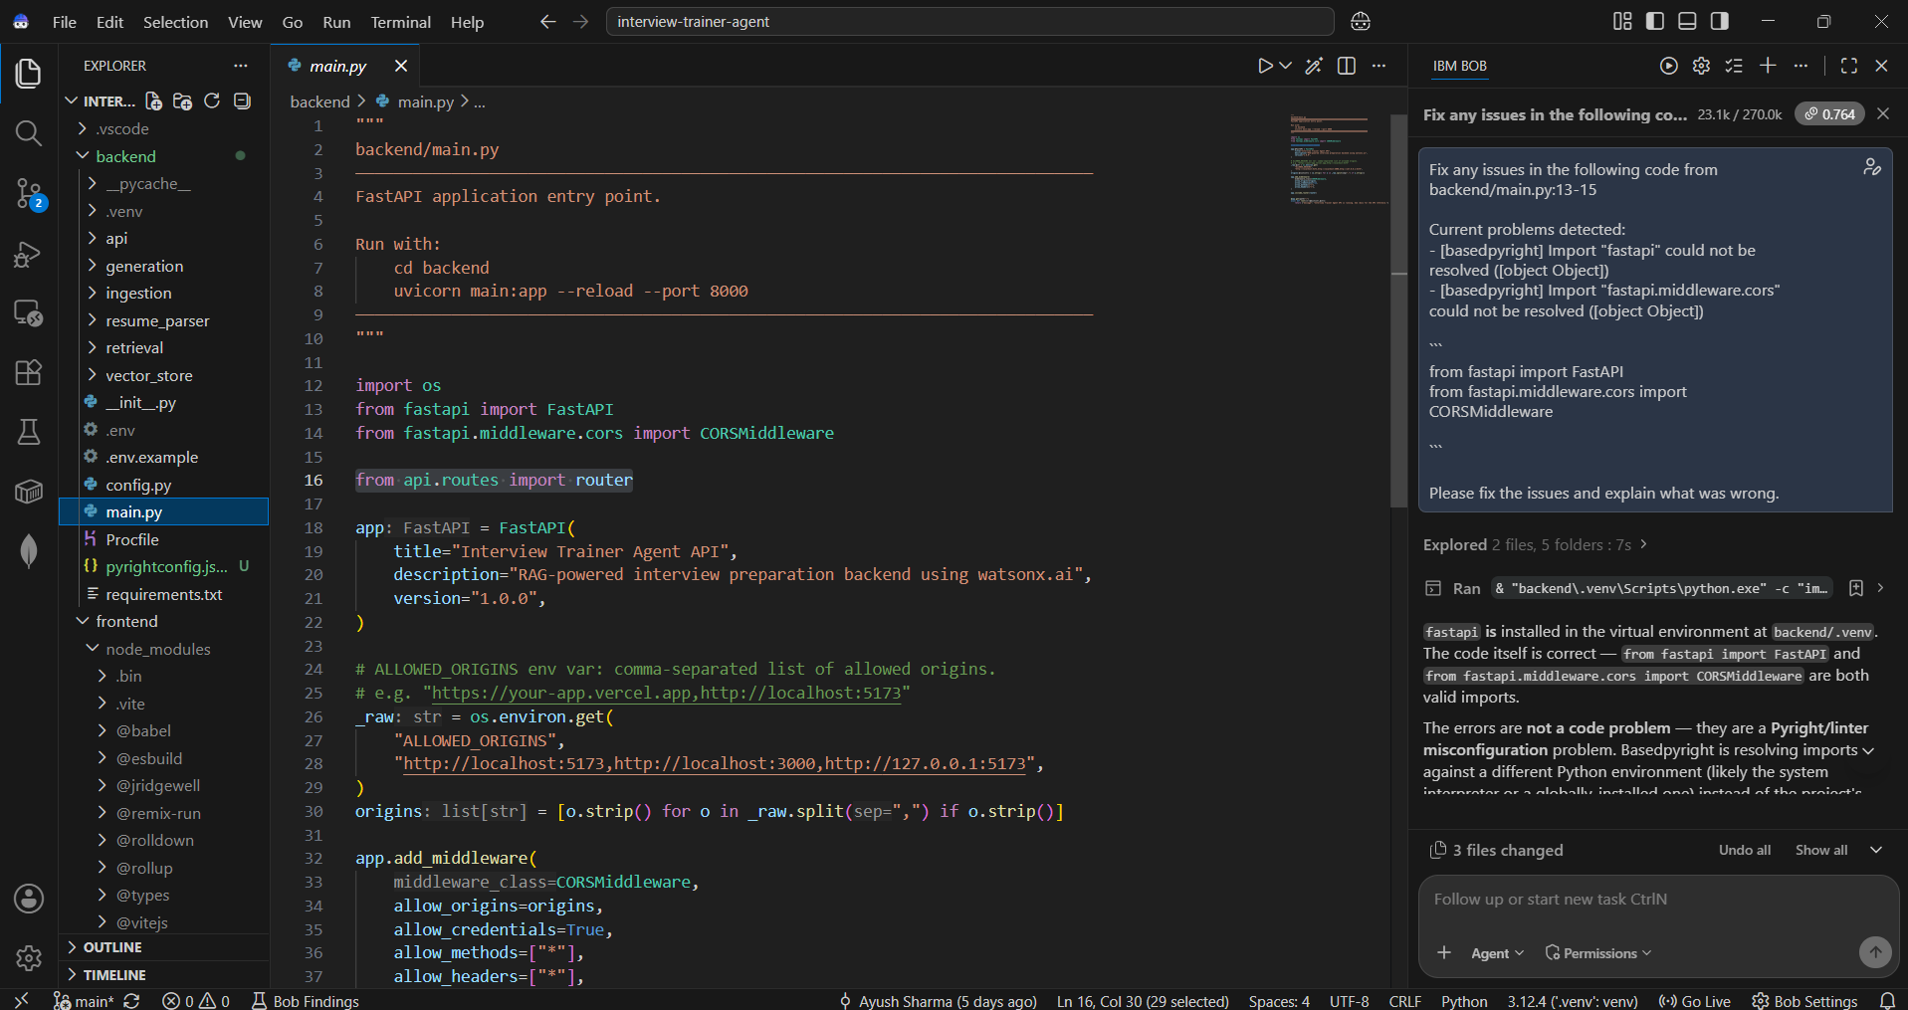

Slide 10
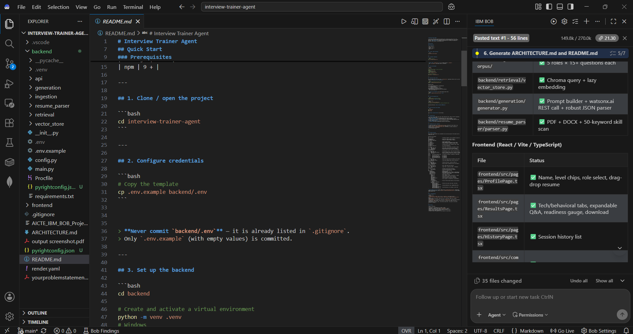

Slide 11
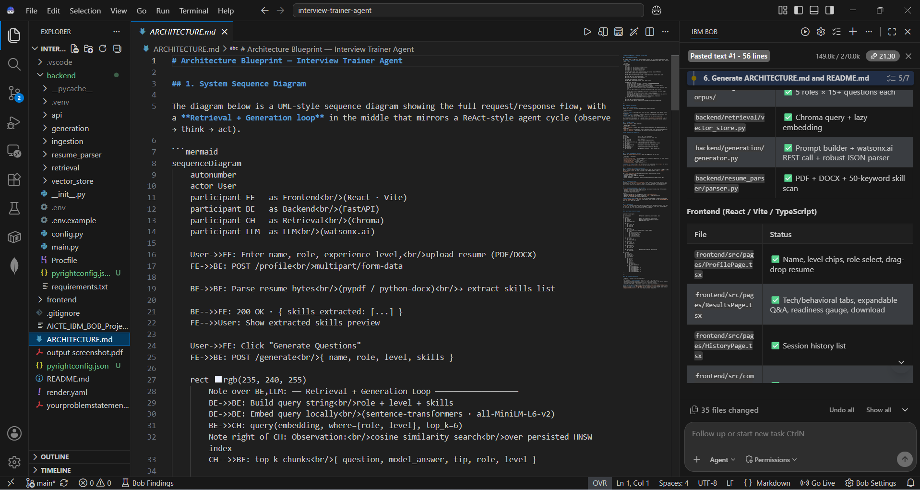

Slide 12
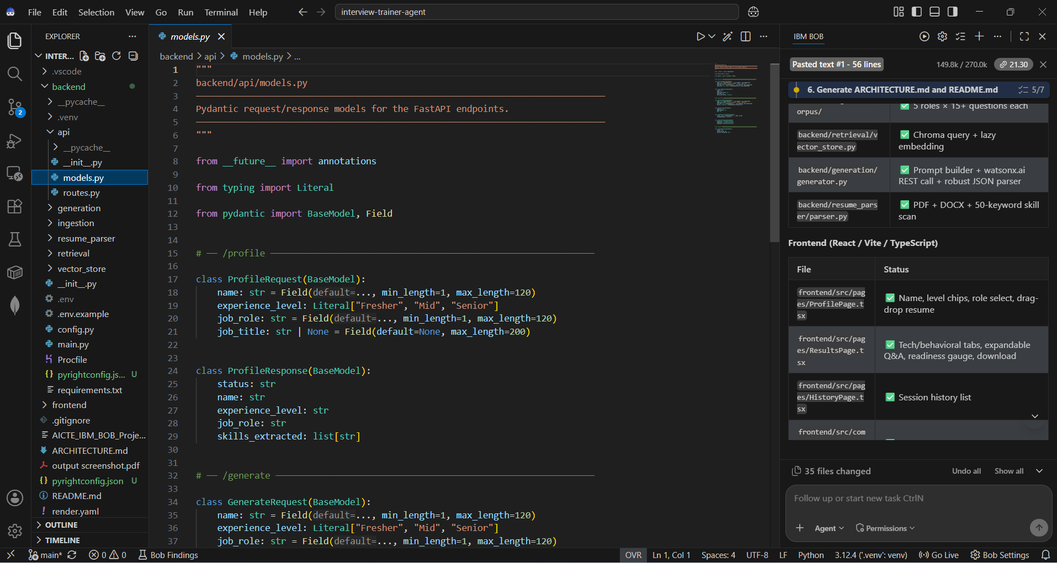

Slide 13
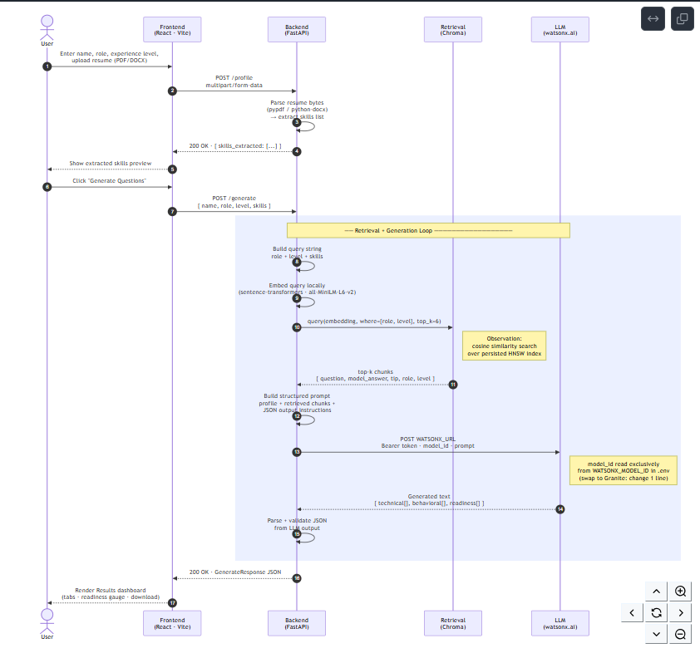
Architecture blueprint for IBM bob:

Slide 14

Role of Agentic AI in the solution
Role of Agentic AI in Interview Trainer Agent
Agentic AI enables the Interview Trainer Agent to function as an intelligent, adaptive system rather than a simple chatbot. Using IBM watsonx.ai and an IBM-hosted foundation model, it coordinates multiple specialized agents to deliver personalized interview preparation.
Each agent performs a specific role—such as retrieving role-specific interview data, generating tailored question sets, providing improvement advice, and analyzing resume/profile input—while working collaboratively. This multi-agent approach ensures efficient task execution and accurate, relevant results.
Agentic AI also brings context awareness, understanding user details like experience level, job role, and resume content to generate tailored questions and answers. It supports real-time adaptation, continuously refining question sets and feedback based on user inputs like resume uploads or updated job roles.
Additionally, agents communicate with each other, enabling better decision-making and more coherent, well-rounded preparation output.
Overall, Agentic AI makes the system proactive, personalized, and goal-driven, acting like a smart digital interview coach that helps users build confidence and succeed in competitive hiring environments.

Slide 15
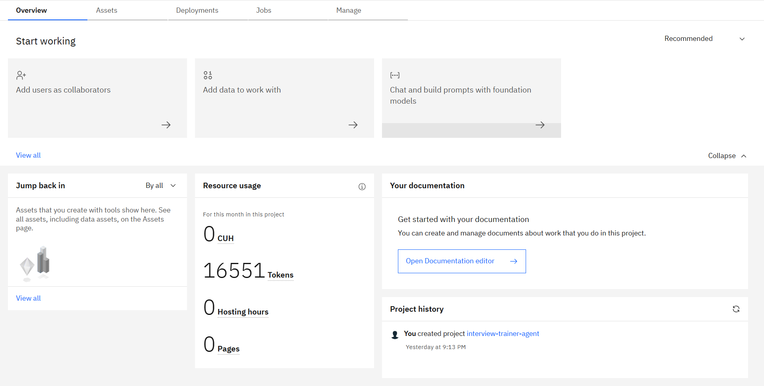
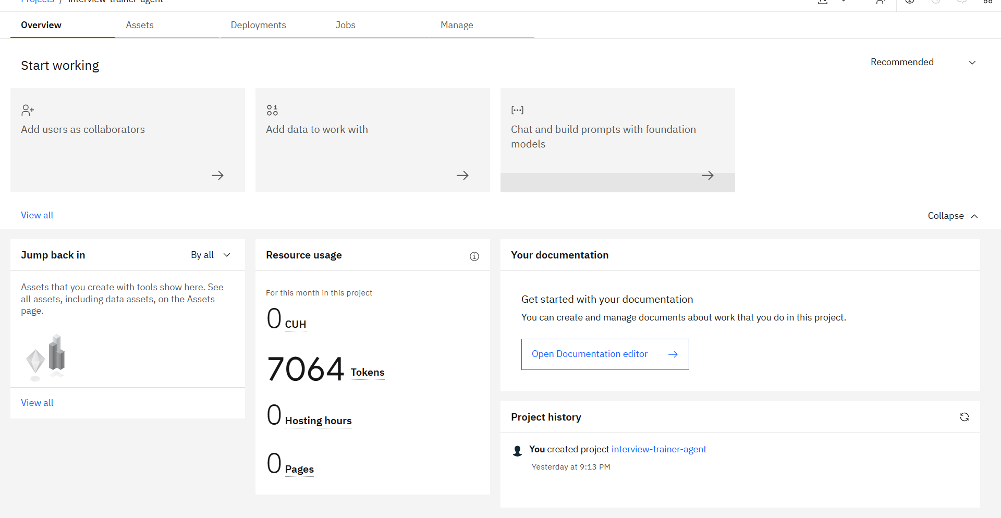
Token Usage
9487 token are used
Before Prompt
After the Prompt
·
·
·

Slide 16
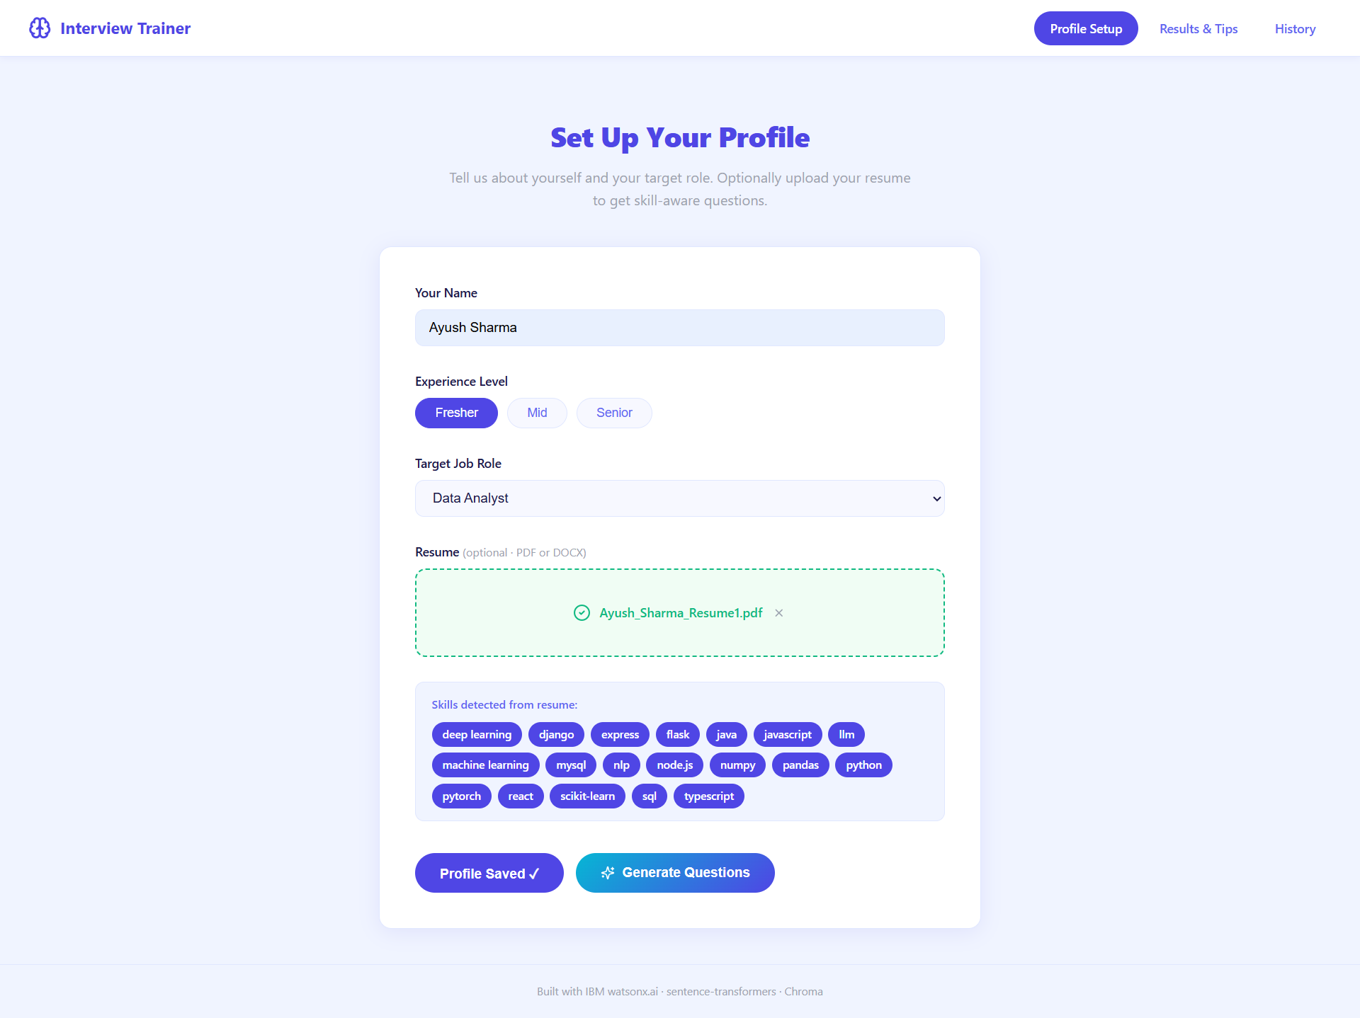
Project Output Screenshot
Please put IBM Bob output screenshots with 2-3 prompts.
You can take 2-3 more slides for each screenshot
·
·
·

Slide 17
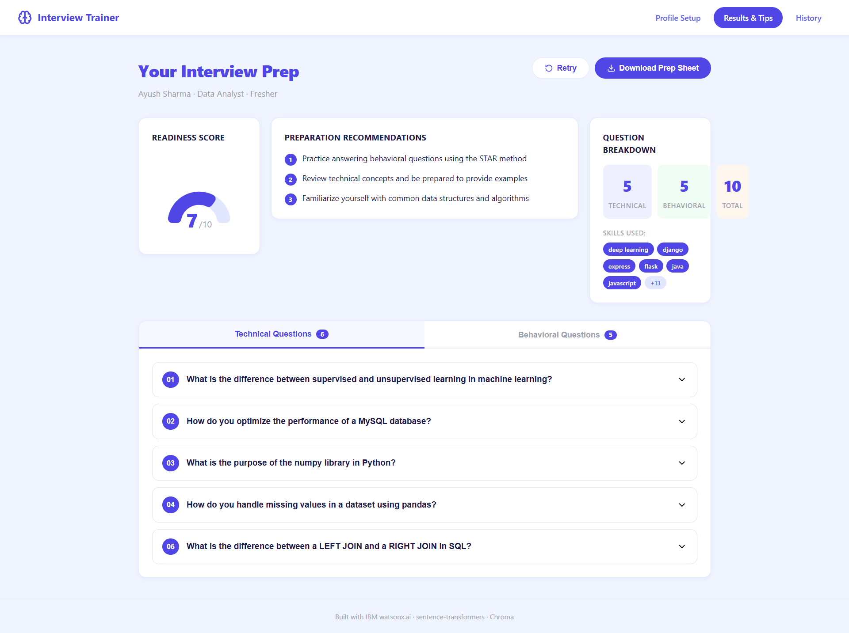
Project Output Screenshot
Please put IBM Bob output screenshots with 2-3 prompts.
You can take 2-3 more slides for each screenshot
·
·
·

Slide 18
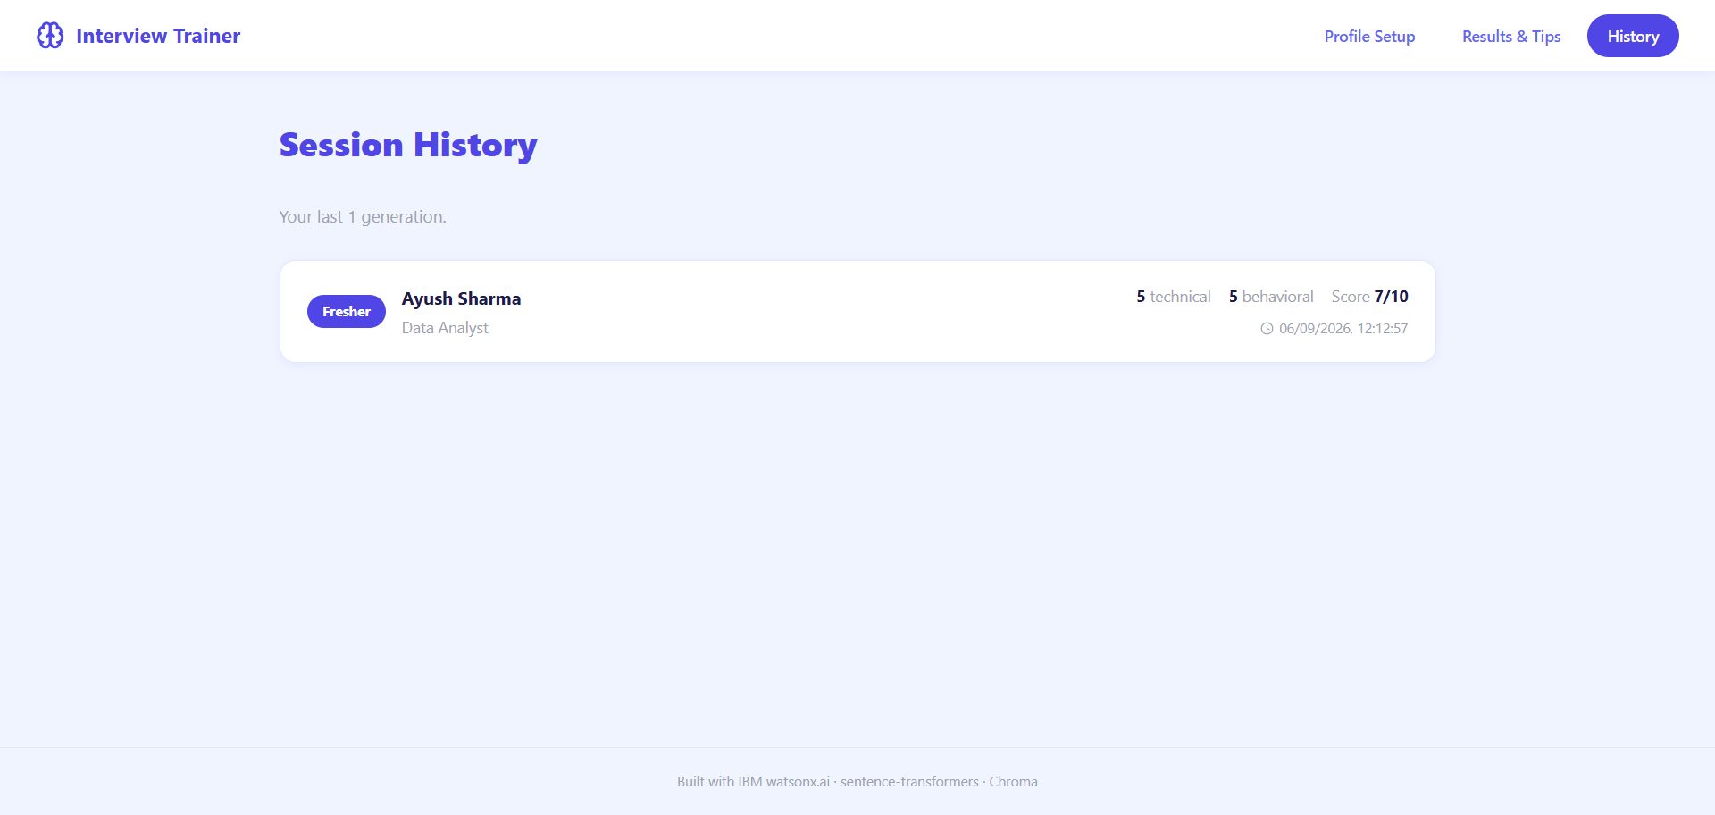
Project Output Screenshot

Slide 19
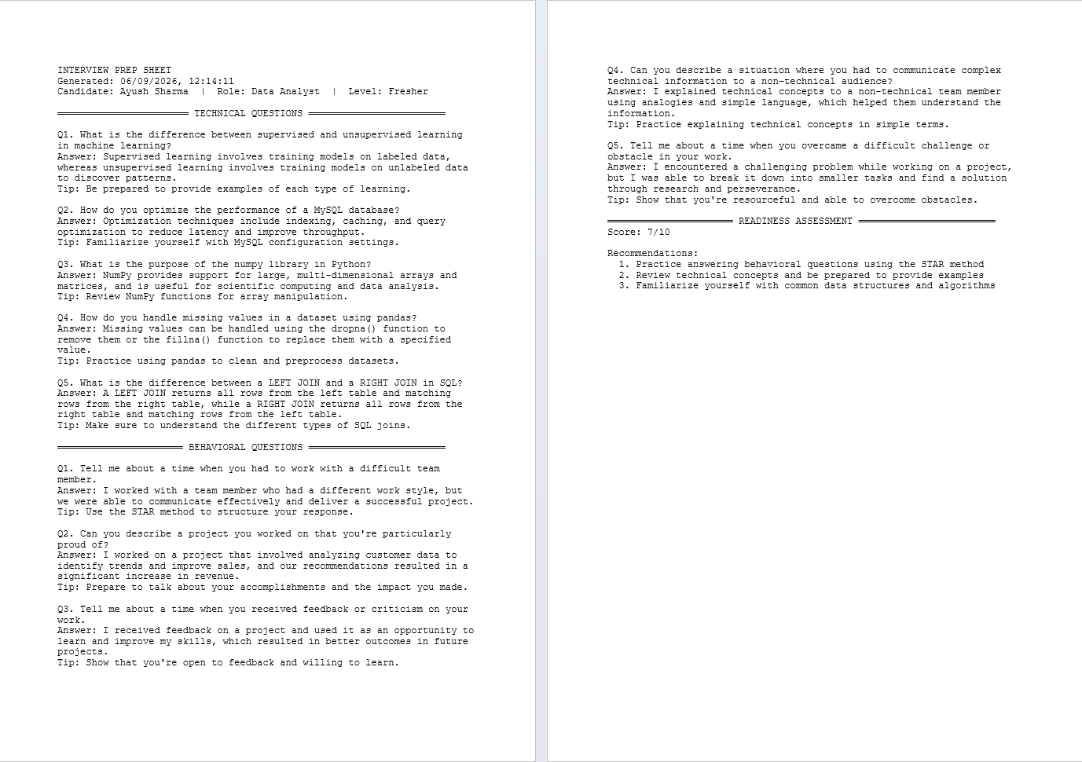
Project Output Screenshot
Please put IBM Bob output screenshots with 2-3 prompts.
You can take 2-3 more slides for each screenshot
·
·
·

Slide 20
Novelty and Uniqueness
The proposed Interview Trainer Agent stands out by combining Agentic AI, RAG, and personalization into a single intelligent system.
Multi-Agent Intelligence – Instead of a single chatbot, multiple specialized agents collaborate to deliver accurate and context-aware interview preparation.
RAG-Based Accuracy – Integrates real-time retrieval of role-specific questions and HR guidelines with AI generation, reducing generic or irrelevant advice and ensuring trustworthy preparation content.
Hyper-Personalization – Tailors question sets and model answers based on experience level, job role, and resume content.
Real-Time Feedback Loop – Continuously adapts question sets and improvement tips as users update their resume or job role.
Flexible Input Options – Supports both resume upload and manually entered job title/role for better accessibility to candidates at any preparation stage.
Confidence & Readiness Focus – Goes beyond generic question lists to provide behavioral coaching and improvement tips, building candidate confidence for real interviews.
Scalable & Enterprise-Ready – Built on IBM watsonx.ai, ensuring reliability within IBM Cloud Lite services.
This makes the solution a smart, adaptive, and proactive digital interview coach, not just a static question-bank tool.

Slide 21
Git Hub Link
Please create public github repository (Enable Add README button while creating repository) with format –
Please test and Paste the working Github URL – https://github.com/ayush-cyber1/interview-trainer-agent
Make sure you have Uploaded following three files into your github repository 1) All Agent relevant files of IBM Cloud , 2) yourproblemstatement.pdf file 3) your projectpresntation.pptx file 4)any other files
·
·
·

Slide 22
Future Scope
Integration with Video/Mock Interview Platforms – The system can be integrated with video conferencing tools or mock-interview platforms to simulate real interview conditions. This will enable the Interview Trainer Agent to analyze spoken responses, pacing, and confidence levels, providing more realistic and dynamic feedback based on how a candidate actually performs, not just what they type.
AI-Powered Voice Assistant & Multilingual Support – Enhancing the system with a voice-enabled assistant and support for multiple languages will improve accessibility. Users can practice answering questions out loud in their preferred language, making the solution more inclusive and suitable for diverse candidates, especially in regions with varied linguistic backgrounds.
·
·
·

Slide 23
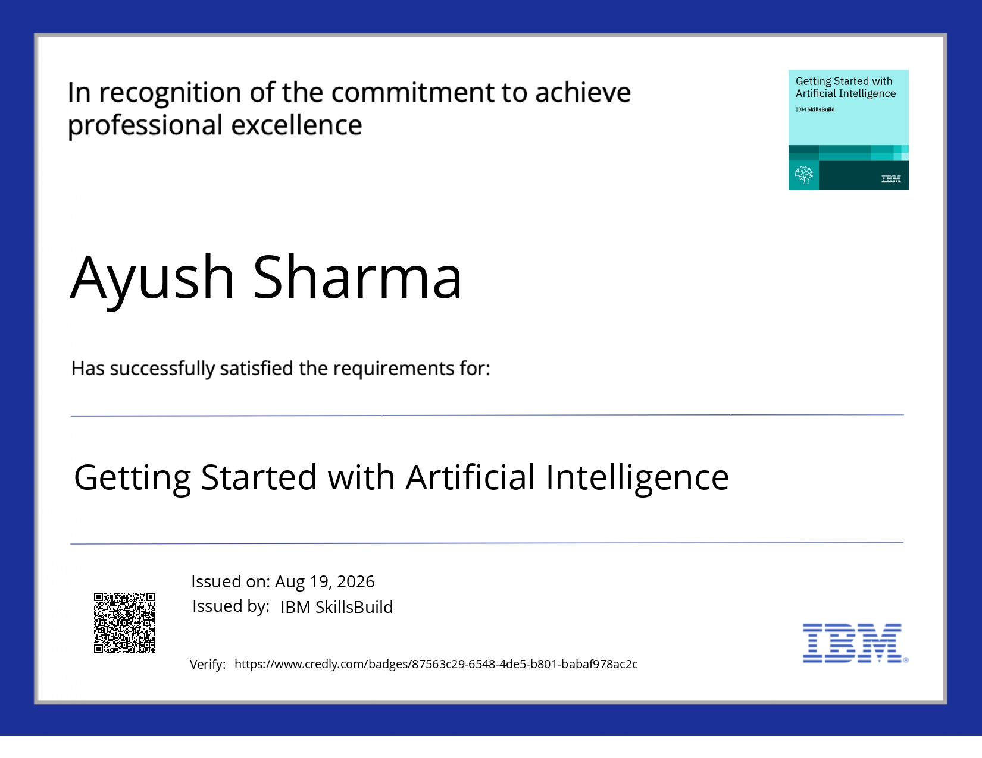
Certificates Earned:
Getting Started with Artificial Intelligence

Slide 24
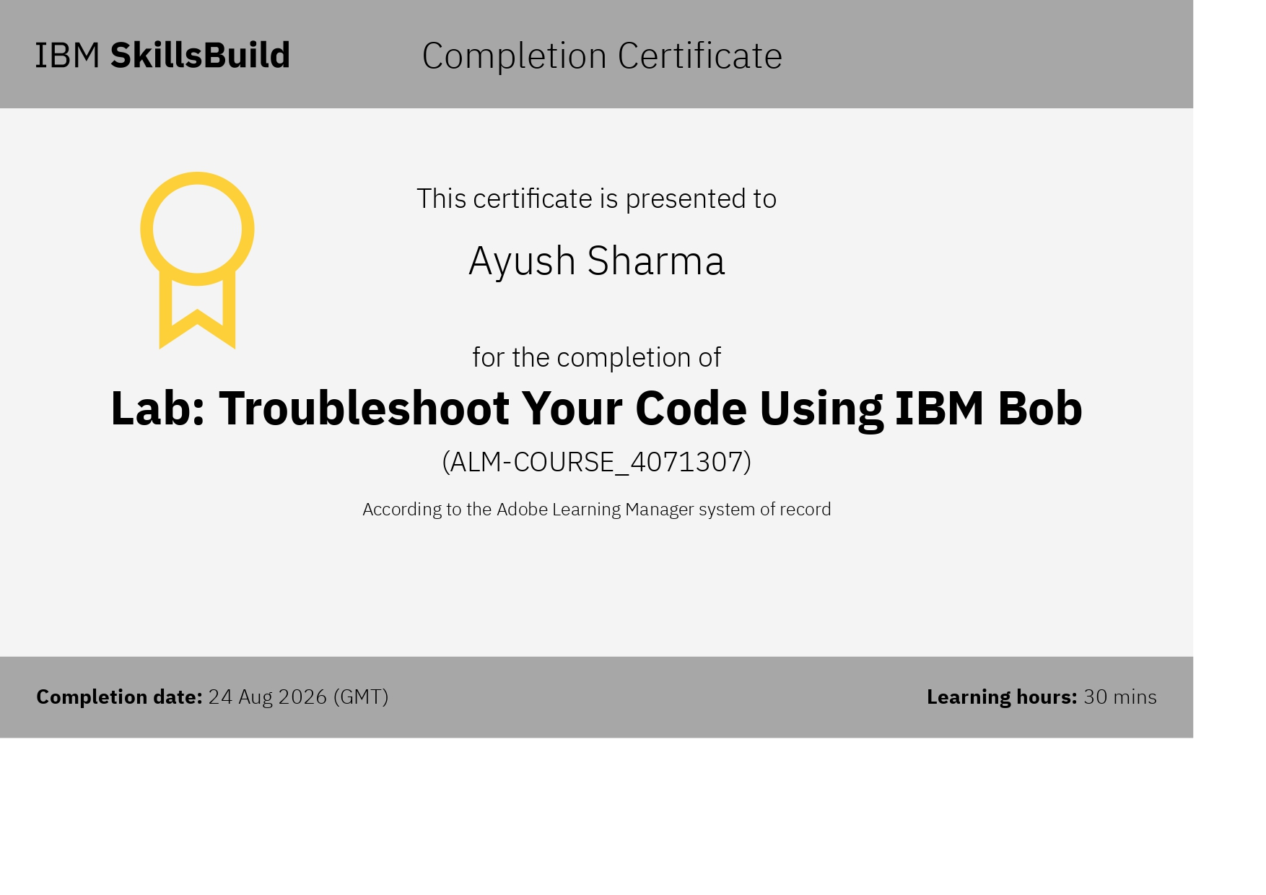
Certificates Earned:​
IBM BOB Certificate

Slide 25


